Slide 1

Lab 10
CSE 2301 – Fall 2024

Slide 2

Weekly News
Exam 2 Grades will be published this week

Slide 3
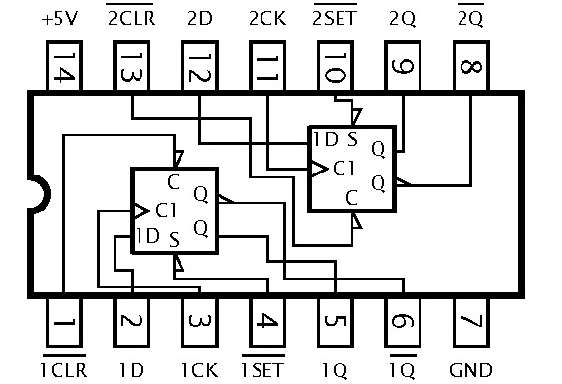
INTRODUCTION: SEQUENCE DETECTION
This lab’s primary objective is to build a circuit that shows how we can detect a specified sequence of bits in a data stream.
In this lab you will build a sequence detector that detects ‘010’ and ‘101’ using D Flip-Flops. However, this cannot be done by simply storing the inputs and reading C’BA' or CB’A. Instead, the output should be determined by state transitions.

Slide 4
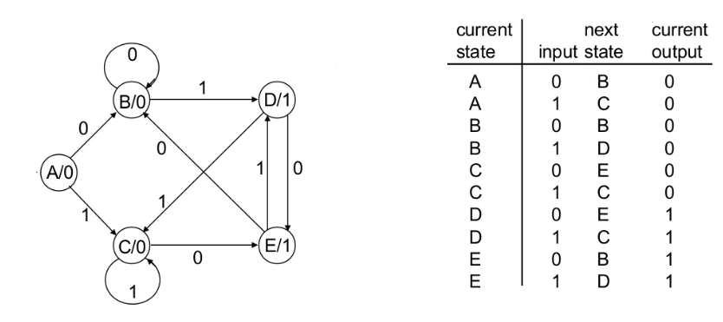
Review: Sequence diagrams
Detector 01 or 10: A Moore machine
Moore Machine: Output is a function of state only
You will be looking for a pattern of bits that can be represented by arrows on a state diagram. The arrows will have associated inputs. That’s your first task – to create the state diagram.
How many states do you need?
Will it be with or without overlap?

Slide 5
Review: detecting a sequence
Let’s do an example with the code 0101.
We’ll start by adding an initial state (no inputs have been given yet, so no pattern has been stored.
S0/0
N/A

Slide 6
Review: detecting a sequence
S1/0
‘0’
Let’s do an example with the code 0101.
0
We’ll start by adding an initial state (no inputs have been given yet, so no pattern has been stored.
S0/0
N/A
Consider the ‘0’ input. This is the first bit in the sequence, so we’ll make a new node for it.

Slide 7
Review: detecting a sequence
S1/0
‘0’
Let’s do an example with the code 0101.
0
Consider the ‘0’ input. This is the first bit in the sequence, so we’ll make a new node for it.
S0/0
N/A
Consider the ‘1’ input. This is not the first bit in the sequence, so we stay in the initial state.
1

Slide 8
Review: detecting a sequence
0
S1/0
‘0’
S2/0
‘01’
Let’s do an example with the code 0101.
0
1
Consider the ‘1’ input. This is not the first bit in the sequence, so we stay in the initial state.
S0/0
N/A
Continue to state 1 (S1). Evaluate what happens at this node when a ‘0’ occurs or a ‘1’ occurs. Notice that if we get another 0, we just stay in the S1 state, otherwise we move on.
1

Slide 9
Review: detecting a sequence
0
S1/0
‘0’
S2/0
‘01’
S3/0
‘010’
Let’s do an example with the code 0101.
0
1
0
Continue to state 1 (S1). Evaluate what happens at this node when a ‘0’ occurs or a ‘1’ occurs. Notice that if we get another 0, we just stay in the S1 state, otherwise we move on.
S0/0
N/A
1
Evaluate S2. This time, if we get a ‘1’, we must start over, because ‘11’ is nowhere in the sequence.
1

Slide 10
Review: detecting a sequence
0
S1/0
‘0’
S2/0
‘01’
S3/0
‘010’
Let’s do an example with the code 0101.
0
1
0
Evaluate S2. This time, if we get a ‘1’, we must start over, because ‘11’ is nowhere in the sequence.
S0/0
0
1
0
Evaluate S3. We complete the sequence. Recognize that you don’t need to add another state for ‘0101’. The point is to output 1, not end up at a “final state”. In this case there’s overlap, so we can return to S2 (in this manner, the sequence would be detected twice from 010101).
1
1
1
S4/1
‘0101’

Slide 11
Review: detecting a sequence
This sequence can be detected with 5 states (4 states if we design a Mealy machine, see the next slide), which means we would only need 3 D flip-flops. Specifically, each state can be represented by a binary code, so S0 would be 000, S1 -> 001, S2 -> 010, and so on.
You can use this information to make the transition table…
0
S1/0
‘0’
S2/0
‘01’
S3/0
‘010’
Let’s do an example with the code 0101.
0
1
0
Evaluate S2. This time, if we get a ‘1’, we must start over, because ‘11’ is nowhere in the sequence.
S0/0
0
1
0
Evaluate S3. We complete the sequence. Recognize that you don’t need to add another state for ‘0101’. The point is to output 1, not end up at a “final state”. In this case there’s overlap, so we can return to S2 (in this manner, the sequence would be detected twice from 010101).
1
1
1
S4/1
‘0101’

Slide 12
Review: detecting the same sequence: A Mealy machine
0/0
1/1
Let’s do an example with the code 0101.
And we’re done! This sequence can be detected with only 4 states, which means we would only need two D flip-flops. Specifically, each state can be represented by a binary code, so S0 would be 00, S1 -> 01, S2 -> 10, and S3 -> 11.
You can use this information to make the transition table…
S1:
‘0’
S2:
‘01’
S3:
‘010’
0/0
1/0
0/0
S0:
N/A
0/0
1/0
1/0

Slide 13
Your Task: Sequence ‘010’ and ‘101’
**This is part of the sequence diagram you’ll be making.
> How can it be expanded to output ‘1’ when it detects the full
sequence?
> Remember that every node should have two outgoing edges!
Create the state diagram for sequence detection. You should get 7 states, with one initial state. (Moore Machine)
Recall that we are NOT storing the sequence directly.
A
0
B
1
N/A
0
D
E
1

Slide 14
Your Task: TRANSITION TABLE
**Your table will be different
Current |  |  | Next |  | Output
QA | QB | X | QA+ | QB+ | Y
0 | 0 | 0
0 | 0 | 1
0 | 1 | 0
0 | 1 | 1
1 | 0 | 0
1 | 0 | 1
1 | 1 | 0
1 | 1 | 1
Make a transition table based on the sequence diagram. Depending on how you name each state, you may have different results than your peers. You should have 3 D flip-flops, so your variables will be QC, QB, QA, QC+, QB+, QA+, X (input), and Y (output).
After this, use K-maps to reduce the equations for QC+, QB+, QA+, and Y so that you can build the circuit.

Slide 15

Other notes DEMO and REPORT
When you demo, you only need one LED (Y output), but it’s recommended that you have 3 additional LEDs for checking your D flip-flops (to debug).
Standard report for this assignment.

